Slide 1

TESL Canada Instructor Certification
PLAR Application Process and
Standard Two Pathway for Standard One Holders
January 2025

Slide 2
Initial Process:
Applications are accepted by mail or email. Applicants can email the application form and proof of TESL Canada membership, only. Official documents must be emailed (or mailed) by the institutions.
TESL Canada membership is required for certification.
The applications are initially reviewed by the certification administrator. If items are missing, the administrator emails the applicant.
If there are items pending, such as transcripts or English Language Proficiency scores, the file is held in a “pending” folder.

Slide 3
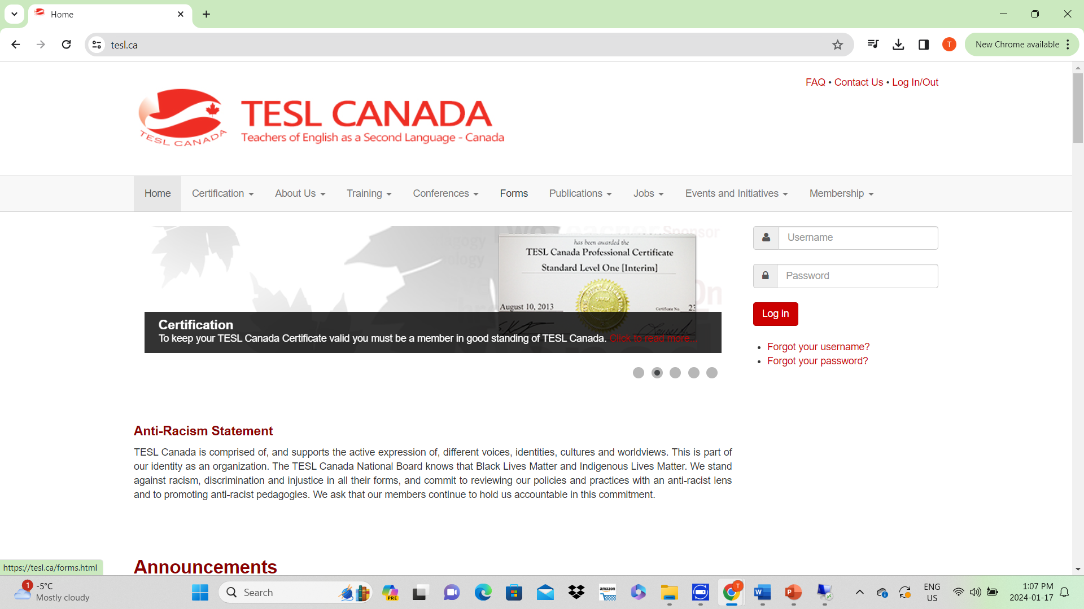
Application forms can be found under the “Forms” tab on the TESL Canada website.
Membership to TESL Canada, whether through direct membership or through a provincial affiliate, can be obtained under the “Membership” tab.

Slide 4
Professional certification pathway to Standard 2 for Standard 1 holders
This pathway allows Standard 1 holders who are actively involved in teaching ESL and in professional development to upgrade to Standard 2 without completing a Standard 2 recognized training program.
The requirements for the certification pathway are outlined on the next two slides and the application form found on TESL Canada’s website at the URL below (or under the “Forms” tab): https://tesl.ca/images/Application_Standard__Two_PD_Pathway_July_2024_.pdf

Slide 5
Eligibility for Standard Two
Applicants are evaluated on a points system
The points are awarded for activities such as:
Years of service (Canadian and/or international) in adult ESL/EFL teaching
Mentoring TESL students
Attending webinars or workshops
Completion of employer PD
Completion of short specialized courses (e.g., 1-8 weeks; 3-9 modules)
Delivering conference presentations, workshops, or webinars
Attending a provincial, national, or international conference
Authoring peer-reviewed articles related to teaching and learning

Slide 6
Eligibility for Standard Two Continued
Consistent membership in TESL professional organizations and active participation in professional learning communities (PLCs)
Reflective-Reflexive Journal documenting impact of particular professional learning opportunity on pedagogy, philosophy, and/or classroom practice.
Learning an additional language as an adult (formal or self-directed) and producing a reflection on how learning an L2 has impacted their teaching

Slide 7
Conditions
Required categories to apply:
  100 accumulated points
  a minimum of 5 years of service
  at least one evaluated activity (e.g., short specialized course, CE or graduate university credit)
  at least have attended one conference or two webinars
  This system of points will allow an applicant to bridge from Standard 1 to Standard 2 or Standard 3 (with a completed graduate degree in a relevant area).

Slide 8
Cost of Standard 2 Certification for Standard 1 Holders Application
Payment of $105.00 ($100.00 plus $5.00 GST) if you live in British Columbia, Alberta, Manitoba, Saskatchewan, Quebec, NWT, Nunavut, and Yukon
Payment of $113.00 ($100.00 plus $13.00 GST) in Ontario
Payment of $115.00 ($100.00 plus $15.00 GST) in Nova Scotia, New Brunswick, Prince Edward Island and Newfoundland and Labrador
Payment of $100.00 U.S. if applying from outside Canada
Note: This fee is non-refundable and will be processed upon receipt of application.

Slide 9
Prior Learning and Recognition
(PLAR) applications
PLAR applications are required for applicants who have completed their ESL/EFL training at a non-TESL Canada recognized teacher training program.
The portfolio is reviewed by an adjudicator to determine equivalency. If they find a component(s) lacking from the portfolio, they will recommend the course(s) that will be needed to meet our standards. Once the portfolio is complete, the applicant will be granted certification if a) the application is equivalent to our standards, or b) the applicant submits the missing components in the prescribed length of time.

Slide 10
Required documentation and questions asked applicants
1. Do you have a Bachelor’s degree?
2. If yes, where was it taken? Check the website at the following link to determine if you need an English Language Proficiency test: https://tesl.ca/certification/tesl-canada-professional-certification/english-language-proficiency-scores.html
3. If it was outside Canada, you will need an equivalency report.
4. Where did you study TESL – was it focused on teaching adults? (K-12 training and experience are not eligible).
5. Did you do a TESL practicum in an adult class? Where? How many hours? Qualifications of sponsor teacher?

Slide 11
Required documentation and questions asked applicants Continued
6. If not, do you have experience teaching ESL to adults? How many classroom hours? Can they be documented? (Teaching other courses to students whose second language is English doesn’t count).
7. Can you produce two performance evaluations, one a class observation by a qualified TESL person?
8. Are you able to describe your TESL courses and provide a bibliography of the resources used and how you were assessed?
9. Do you know the qualifications of your instructor(s)? (Must have TESL or Applied Linguistics training)

Slide 12
Initial Process
The applications are initially reviewed by the certification administrator. If items are missing, the administrator emails the applicant.
The items which are required are outlined on the application form: https://tesl.ca/images/INTERNAL_PLAR_APPLICATION_October_2024.pdf
As previously mentioned, the applicant is emailed if items are missing or the application form is not completed correctly.

Slide 13
Experience vs practicums
Practicum requirements can be met by submitting proof of teaching ESL/EFL to adults, over the age of 18, in classroom settings of 5+ students.
The hours must be confirmed by the employer and an observation report is also required.
1000 hours of paid employment are required for Standard One while 2000 hours are required for Standards Two and Three.
Applicants are required to request officially submitted documentation by an employer to TESL Canada demonstrating 1000 hours for Standard One or 2000 hours for Standards Two and Three of teaching ESL to adults over the age of 18 in classroom settings of 5+ students.

Slide 14
Practicums
  *For all practicums, the practicum supervisor must be certified at a minimum of TESL Canada Professional Certificate: Standard 2 with at least 2,000 hours of experience in an adult English language teaching classroom, or equivalent.

Slide 15
Cost of PLAR Application
Payment of $304.50 ($290.00 plus $14.50 GST) if you live in British Columbia, Alberta, Manitoba, Saskatchewan, Quebec, NWT, Nunavut, and Yukon
Payment of $327.70 ($290.00 plus $37.70 GST) in Ontario
Payment of $335.00 ($290.00 plus $43.50 GST) in Nova Scotia, New Brunswick, Prince Edward Island and Newfoundland and Labrador
Payment of $290.00 U.S. if applying from outside Canada
Note: This fee is non-refundable and will be processed upon receipt of application.

Slide 16
Thank you
Any Questions?

